Slide 1
Learning Objectives
Identify at least 3 major pediatric mental health diagnoses & how they might present in a crisis
Name the mental health conditions that are most associated with substance use
Identify 3 major risk factors for suicide attempt or completion

Slide 2
Common Psychiatric Conditions
Developmental Disorders
Autism Spectrum Disorder
Disruptive Disorders
Attention Deficit Hyperactivity Disorder
Conduct Disorders
Emotion & Thought Disorders
Major Depressive Disorder
Anxiety & Obsessive-Compulsive Disorders
Post Traumatic Stress Disorder (PTSD)
Pediatric Psychosis
Substance Use Disorders

Slide 3
Autism Spectrum Disorders (ASD)
Deficits in social communication
Social-emotional reciprocity
Non-verbal communication
Interpersonal relationships
Restricted & repetitive patterns of behavior, interest, or activities
Repetitive behaviors – repeating words, hand flapping, lining up toys
Excessive adherence to routines or resistance to change
Restricted & fixated interests – abnormal in intensity and focus
Unusually high or low sensitivity to sensory input

Slide 4
Mental Health Outcomes
More likely to experience other mental health problems
70% have at least 1 behavioral or emotional disorder
50% have 2 or more co-occurring disorders
Can be hard to tease out which symptom is related to which disorder
Social anxiety
Repetitive thoughts & actions
Cognitive & language impairments
Associated with challenging behaviors
Irritability
Aggression
Self-injury

Slide 5
Evidence Based Treatment
Psychosocial Interventions
Meant to improve emotional and social interactions with peers & caregivers
Physical and Occupational Therapy
Speech & language Therapy
Medications
Aripiprazole (Abilify)
Risperidone (Risperdal)
Non-evidence-based interventions
Sensory integration therapy
Animal-assisted therapy

Slide 6
Attention Deficit Hyperactivity Disorder (ADHD)
Neurodevelopmental disorder characterized by significant symptoms of inattention and/or hyperactivity
Inattention
Hyperactivity
Impulsivity
Hyperactive type disproportionally diagnosed in boys
Inattentive type disproportionally diagnosed in girls
Impede expected developmental functioning
"Adult ADHD" - DSM-5 specifically characterizes ADHD as a pediatric developmental disorder
Symptoms present during childhood

Slide 7
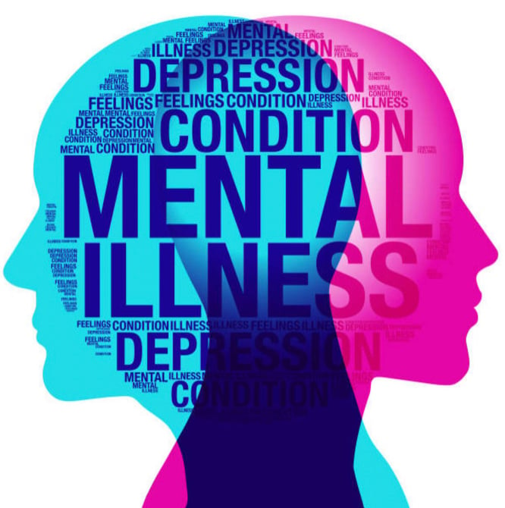
Mental Health Sequelae
Increases by 10x the likelihood of developing Oppositional Defiant(ODD) Disorder, Conduct Disorder (CD), and/or Antisocial Personality Disorder (ASD)
54-76% show symptoms consistent with ODD
20-50% show CD
12-15% of adolescents will develop ASP
Substance Use Problems
6x more likely to misuse nicotine, alcohol, or other drugs later in life
Most common drug is nicotine
Unique & specific predictor for smoking & vaping
This Photo by Unknown author is licensed under CC BY-SA.

Slide 8
Social & Medical Sequelae
Academic problems
Parent-child interactions
Peer rejection & peer neglect
As many as 70% of kids with ADHD may not have a single friend in school
Sleep problems
Can make symptoms much worse
Sluggish-cognitive tempo
Appears drowsy
Frequently daydreaming
Appears apathetic or withdrawn
Doesn't process questions appropriately

Slide 9
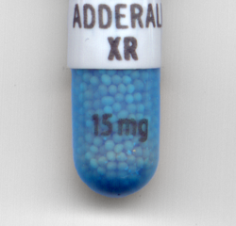
Evidence-Based Treatment
Medications are first line treatment
Stimulants
Adderall (amphetamine salts)
Ritalin (methylphenidate)
Bind to dopamine receptors in the front cortex or striatum
Potential for abuse
Non-stimulant medications
Strattera (atomoxetine)
Guanfacine (Intuniv)
Clonidine
Cognitive-Behavioral Therapy

Slide 10
Conduct Disorders
Oppositional Defiant Disorder (ODD)
Conduct Disorder (CD)
Intermittent Explosive Disorder (IED)

Slide 11
Oppositional Defiant Disorder
Pattern of noncompliant, defiant, and/or spiteful behavior towards others
3 categories:
Angry/irritable
Argumentative or defiant
Vindictiveness towards others
Category of ODD can help predict later developmental outcomes(conduct disorder for example)
Causes increased distress in children and their caretakers and negatively impacts educational and social development

Slide 12
Conduct Disorder
Repetitive and persistent pattern of behavior in which youths violate the basic rights of others or major age-appropriate social rules
Aggression to people or animals
Destruction to property
Deceitfulness or theft
Serious rule violations
Range of anti-social behaviors
Larger & heterogenous group of youths
Different than ODD

Slide 13
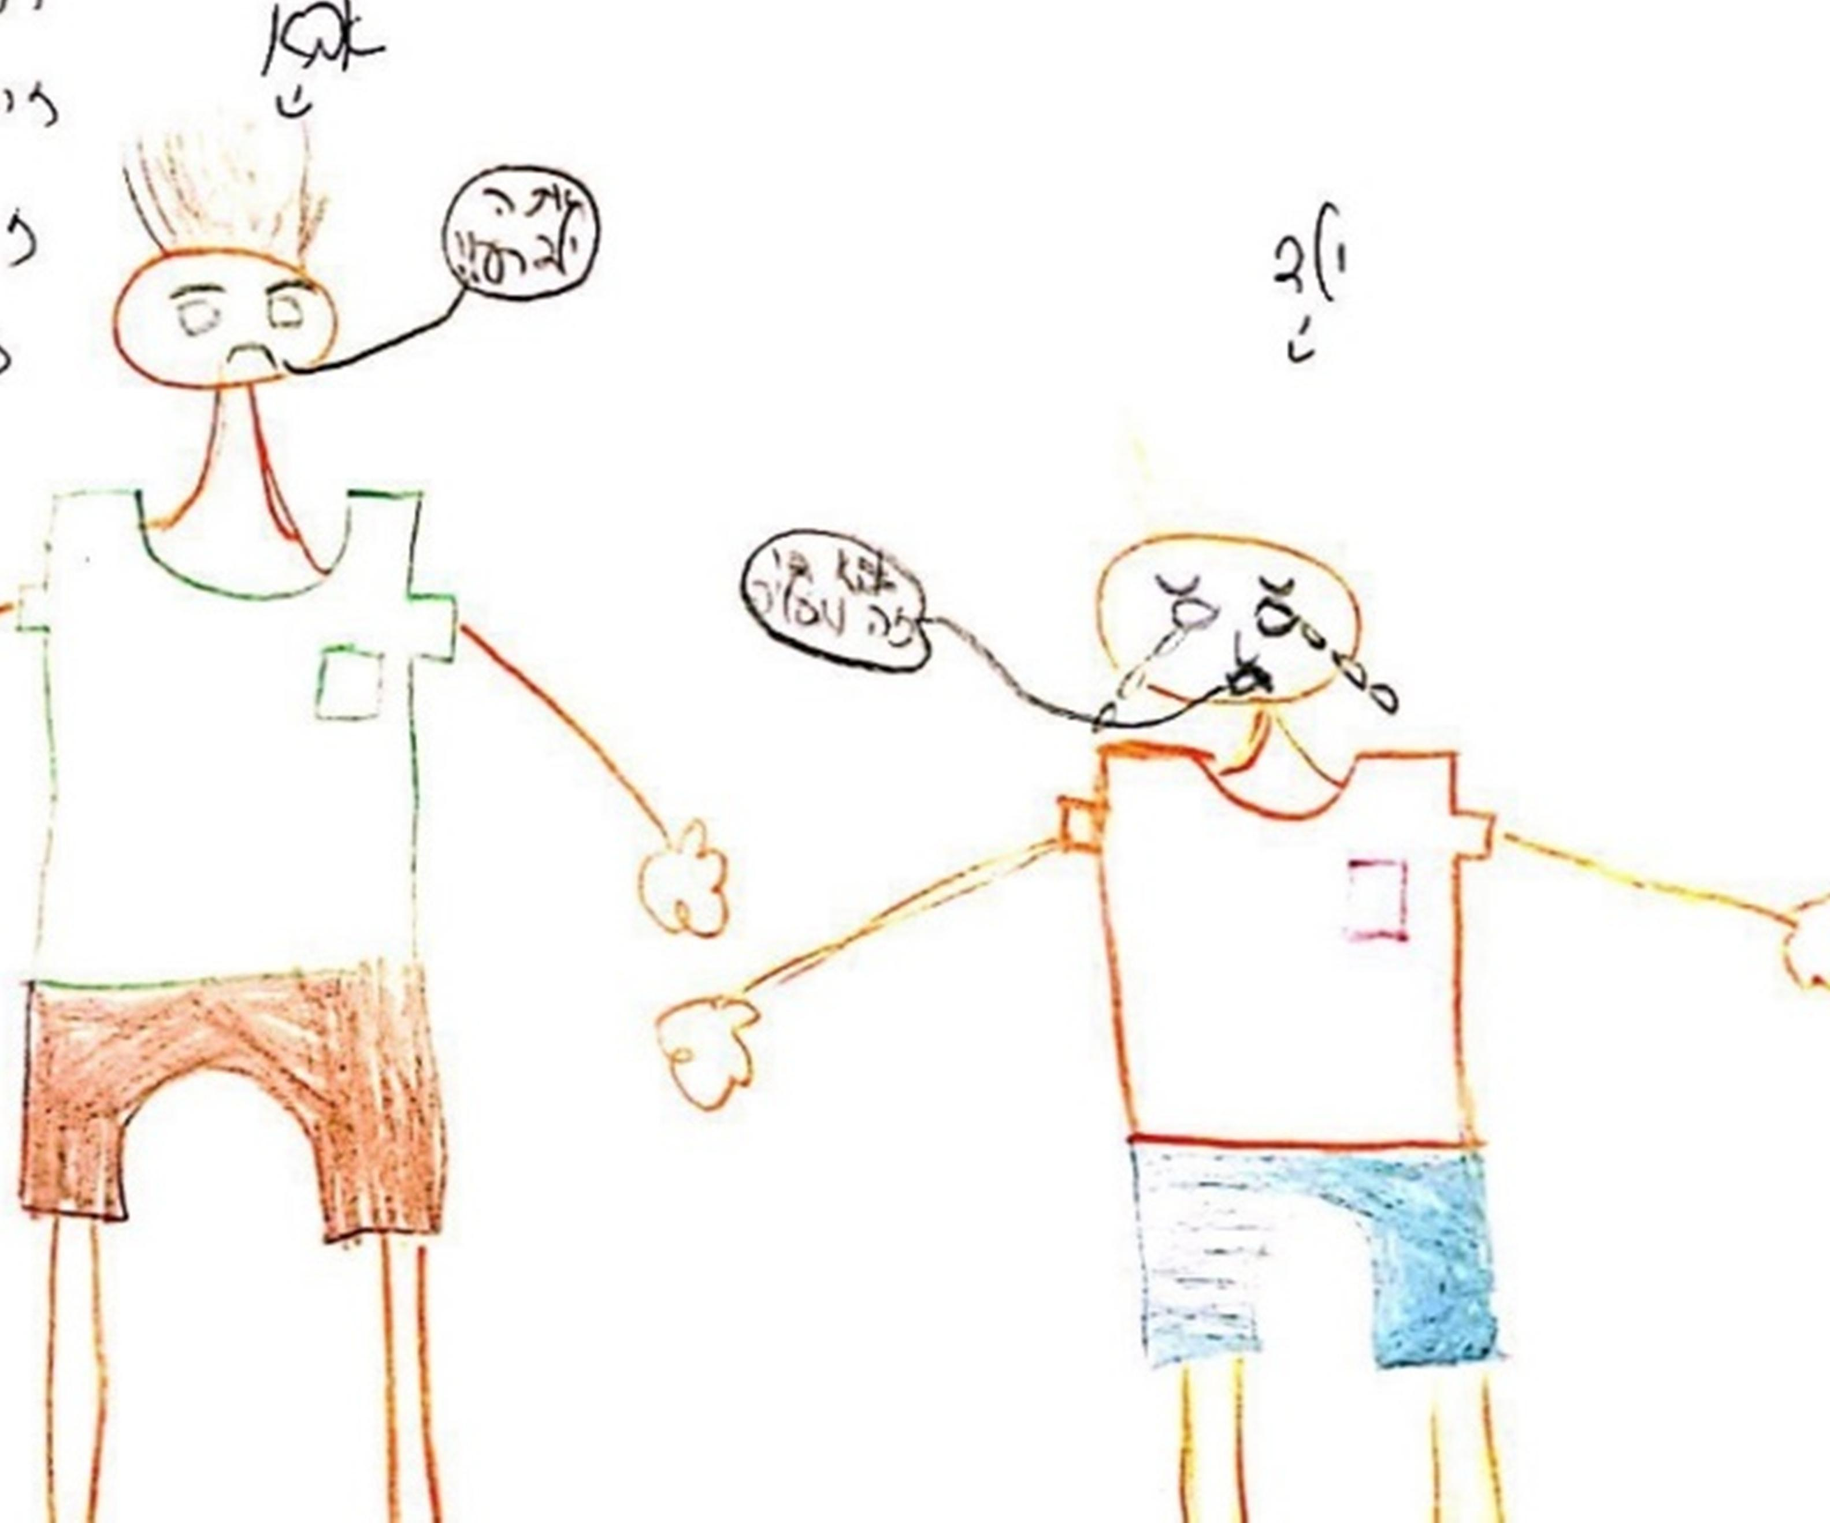
Intermittent Explosive Disorder
Repeated angry outbursts that result in verbal and/or physical aggression
Frequent & minor aggression – name calling, swearing, shoving others
Less frequent but more harmful aggression – biting, hitting, throwing objects
Must show aggression to be diagnostic criteria
Typically show aggression towards family members, friends, or classmates
Report feeling out of control during aggressive acts & often feel remorseful or embarrassed
Reflects an overreaction to anger or frustration
Acts are impulsive (not premeditative)

Slide 14
Conduct Disorders
Frequently seen with ADHD – relationship between 2 is unclear
Increased risk for Substance Use Disorders
Starting using nicotine, alcohol, or other drugs earlier
6x more likely to develop a substance use disorder across the lifespan
Genetic link? Reward sensitivity? Environmental influences?
Academic difficulties
Conduct problems often run in families
Negative parent interactions can reinforce problematic behavior

Slide 15
Treatment of CDs
Variety of CBT based, and parent interaction therapies exist
Must be family based with low barrier services available
Individualized for the client and family
No medications specifically to treat CDs
Treat underlying ADHD
Antipsychotics to reduce aggression/violence
What doesn't work
Incarceration & other forms of severe punishment
Can increase the likelihood of re-offense & continued criminal behaviors as adults
Deterrence programs (i.e. "scared straight")
Wilderness challenge programs
Some group therapies – can engage in deviance training while with other antisocial youths

Slide 16
Major Depressive Disorder
Depressed or irritable mood
Diminished interest or pleasure in most activities
Significant change in appetite or weight
Significant change in sleep
Psychomotor agitation or decrease
Loss of energy or fatigue
Feelings of worthlessness & guilt
Thought process & concentration problems

Slide 17
Depression in Adolescents
10.6% of youths experience depression before adulthood
Girls are 2x more likely to experience depression
Can be more impairing in girls
Excessive empathy
Excessive compliance
Emotional overcontrol
Many more youths experience depression than are ever formally diagnosed
Relapse/recurrence of symptoms is common
Complicated relationship with anxiety disorders
This Photo by Unknown author is licensed under CC BY-NC.

Slide 18
Treatment
Psychoeducation & therapy
Social interaction & setting of SMART goals
Medication
SSRIs
SNRIs
Associated with a small, but significant, increase in suicidal thoughts (not actions)
Most effective combination is therapy & medication

Slide 19
Anxiety and Obsessive-Compulsive Disorders
Anxiety – complex state of psychological distress that reflects emotional, behavioral, psychological, and cognitive reactions to threatening stimuli
Fear – behavioral and psychological reaction to immediate threat
Worry – cognitive reaction to anticipation of future events
Pediatric anxiety exists on continuum based on age & development
Adaptive – helps kids achieve developmental stages & goals
Maladaptive – extreme symptoms that extend beyond development stage & interfere with expected activities

Slide 20
Anxiety Disorders in Children
Most frequently diagnosed condition in children & adolescents
Categories:
Separation anxiety disorder
Selective mutism
Specific phobias
Social anxiety disorder
Generalized anxiety disorder
Persist across childhood & adolescence
Predict negative developmental outcomes
Major depressive disorder
Substance use disorders
Suicidal behavior

Slide 21
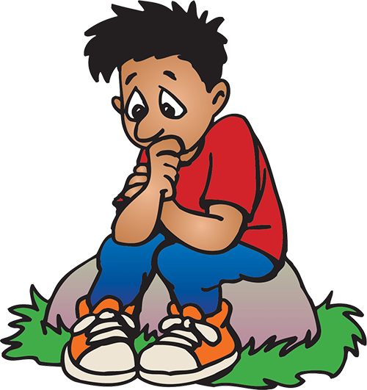
Generalized Anxiety Disorder
Characterized by worry, not fear
More closely related to depression - appx 50% of youth with GAD also have depression
Developmentally, ability to worry & dwell on negative events starts around age 8
Worries interfere with their daily lives
Causes distress & takes time & energy
Interferes with ability to concentrate on important tasks and activities
Mood problems, frustration, and irritability
Somatic problems – headaches, abdominal pain, fatigue
Interferes with development of more adaptive coping strategies

Slide 22
Obsessive Compulsive Disorder (OCD)
Characterized by presence of recurrent, unwanted obsessions or compulsions that are time consuming, case marked distress, or significantly impair daily functioning
Obsessions – persistent thoughts, urges, or images that are unwanted and intrusive
Contamination
Recurrent doubts
Need for order & symmetry
Aggressive or horrific impulses
Compulsions – repetitive behaviors or mental acts that child feels driven to perform in response to an obsession or according to rules that must be applied rigidly
Washing, cleaning, counting, checking, repeating, ordering
Performed in a rigid and idiosyncratic way

Slide 23
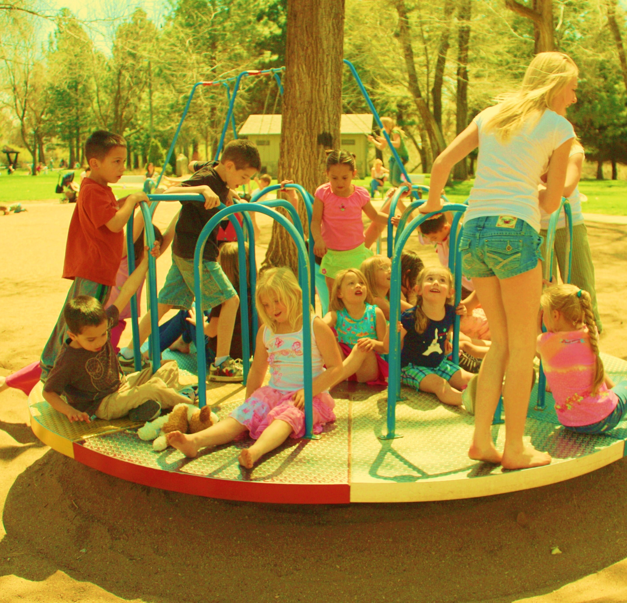
Pediatric OCD
Neurodevelopmental disorder that is highly genetic
Children may be convinced that their thoughts will come true
Obsessions and compulsions are more often vague and magical
Mental rituals – often overlooked by caregivers
Persistent over time – increased risk for relationship, employment, and emotional problems into adulthood
Associated with:
Tic disorders
Tourette's disorder
Trichotillomania
Excoriation disorder

Slide 24
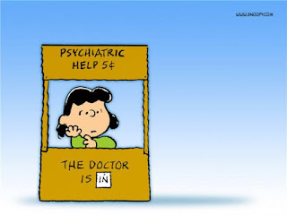
Treatment for Anxiety Disorders
Cognitive Behavioral Therapy
Exposure & response prevention – first line for OCD
Medication
SSRIs
Alpha 2-adrenergic agonists – clonidine, guanfacine
Best outcomes combine therapy & medication

Slide 25
Trauma Based Disorders
Reactive Attachment Disorder (RAD)
Child Maltreatment
Physical abuse
Sexual abuse
Psychological abuse (mental injury)
Neglect
Not a diagnosis itself – increases risk for development of other psychiatric problems
Post traumatic stress disorder (PTSD)

Slide 26
Dysphoric Mood Disruptive Disorder (DMDD)
No known cause
Triad of symptoms:
Major depression
Mania
Hypomania
Often co-occurs with other mental health conditions
Anxiety disorders
ADHD
Eating disorders
OCD
Personality disorders
Substance use disorders
Treatment
Medication first for stabilization
Therapy
Lifestyle changes to avoid triggers

Slide 27
Mania
Significant changes in mood, thinking, energy level, and behavior
Euphoria or greatly increased mood often associated with disinhibition
Marked decreased need for sleep
Impulsive or risky behavior – spending lots of money, high risk sex, driving recklessly
Racing thoughts, distractibility, difficulty distinguishing relevant and non-relevant thoughts
Speech is often rapid, pressured, loud, difficult to interrupt
Can result in psychosis
High likelihood for hospitalization to protect self and others from risky behavior

Slide 28
Panic Disorder
Hallmark is unexpected panic attacks
"Panic attack" = abrupt and unexpected surge of intense fear or discomfort that occurs from a calm or anxious state
Typically peak within minutes and resolve within an hour
Can be triggered or untriggered
Symptoms include:
Fear of death
Palpitations
Tremors
Sweating
Chest pain
Nausea, stomach discomfort
Fear of choking or smothering
Fear of dying

Slide 29
Medications for Panic Disorder
SSRI's
SNRI's
Long-acting benzodiazepine (clonazepam)

Slide 30
Post-traumatic Stress Disorder (PTSD)
Marked cognitive, affective, or behavioral symptoms in response to reminders of a traumatic event
Experience of severe trauma either directly or vicariously
Recurrent experience of trauma may be present

Slide 31
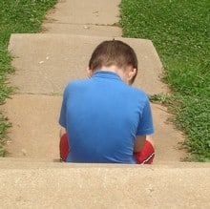
PTSD Symptom Cluster
Intrusion Symptoms - "re-experiencing" the event
Intrusive thoughts
Flashbacks
Can be seen through play in younger children
Avoidance Symptoms
Negative Thoughts and Emotions
Anxiety, depression, guilt, anger
Emotional "numbing"
Arousal and Reactivity
Hypervigilance
Easily provoked – irritable and quick to anger
Self-destructive behavior
Concentration & sleep problems

Slide 32
PTSD in Children
Significant distress or impairment in social interactions, school, and other activities
Most common is direct exposure to physical violence
Most common symptoms are:
Persistent avoidance of people or places associated with the trauma
Distress or anxiety when reminded of traumatic event
Increased irritability & temper tantrums
Sleep problems
Children as young as preschool can develop PTSD
Often show symptoms through repetitive play, demand avoidance, and temper tantrums
Girls are 2-3x more likely to develop PTSD
Possibly related to increase in interpersonal trauma like sexual assault
Associated with conduct disorder, depression, anxiety, and substance use disorders

Slide 33
Evidence Based Treatment for PTSD
Trauma informed care – general approach to providing sensitive & responsive treatment to survivors
Psychological first aid
Preventative of PTSD after experiencing a catastrophic event
Prolonged exposure therapy (PET)
Trauma-focused Cognitive Behavioral Therapy (TF-CBT)
Medications to treat underlying mood or regulation disorders – can help kids tolerate PET and/or TF-CBT

Slide 34
Pediatric Schizophrenia & Psychosis
Psychotic disorder in which the youth's thoughts, feelings, and actions reflect a lack of contact with reality
Highly genetic
Rare in kids – significant impairment when present
Typically emerges in early 20's
Distinct stages of disease each with their own unique symptom cluster
Premorbid – early childhood – developmental delays
Prodromal – noticeable symptoms emerge 2-6 years before first psychotic episode – general decline in functioning
Acute – positive symptoms
Residual – chronic problems

Slide 35
Pediatric Schizophrenia Symptoms
Hallucinations (auditory or visual)
Delusions (fixed thought processes)
Peculiar speech & language
Disturbances in movement & coordination
Disturbances in affect
Diminished emotional expression
Inappropriate emotional reactions to stimuli
Mood disturbances
Psychosis can occur with acute mania and/or substance use

Slide 36
Schizophrenia Treatment
Medications!
Conventional antipsychotics
Haldol most well known
Lots of side effects – tardive dyskinesia
Atypical antipsychotics
Aripiprazole (Abilify), olanzapine (Zyprexa), quetiapine (Seroquel), risperidone (Risperdal)
38-72% of youths show symptom reduction with medication
Recommended use for 6-18 months after first psychotic episode
71-77% of youths stopped taking medication within first 180 days
Predictive of relapse

Slide 37
Comorbid Problems
Appx 50% of adolescents with SUD show at least 1 other mental health condition
Between 60-90% of youth referred for SUD treatment have a comorbid mental health problem
Adolescents are more likely to show disruptive & antisocial behavior (vs adults who are more likely to show mood & anxiety disorders)
ADHD is most frequent co-occurring disorder – 50-75%
When both are present, symptoms are more severe for each disorder
Depression – 25-50%
Anxiety – 10-40%

Slide 38
Clinical Pearls
Pediatric psychiatric conditions frequently cause behavioral disturbances
What appears criminal may have roots in mental health problems
Be trauma informed – with youth and families
The family system is the best agent for change
Incarceration and "scared straight" is ineffective and/or harmful for youth with conduct disorders

